Slide 1
Platinum Data Project Wang Biyuan
2016.08.2 Presentation

Slide 2
Project Progress
Step I: Import data into MATLAB 【Done+Improved】
Step II: Data interpolation 【Debugging】
Step III: Data average 【Done】

Slide 3
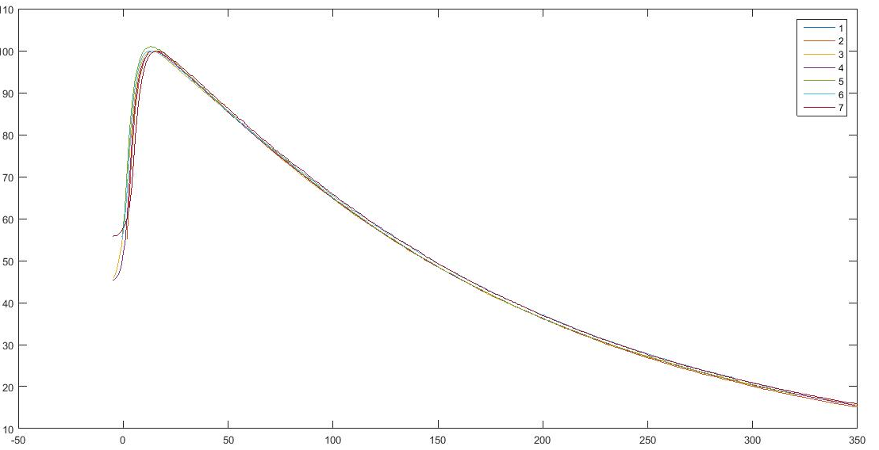
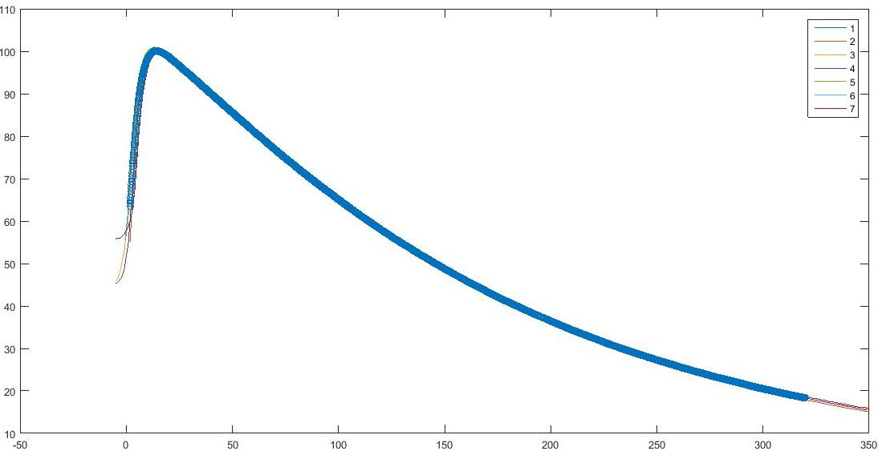
Project Progress
Recap: Step II Data Interpolation
Function: ynew=interp1(x,y,xnew)

Slide 4
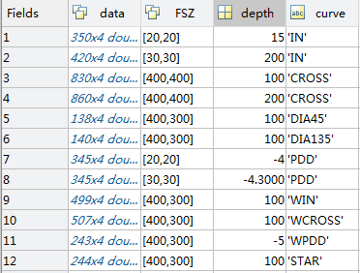
Project Progress
Recap: Step I Import data into MATLAB Imrovement
-Nx7 matrix
FSZ | FSZ | X | Y | Z | DOSE | WEDGE
-Store in struct
Expectation: Convenience of classification
Avoid more for loop
Calculation efficiency has been improved a lot

Slide 5
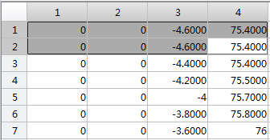
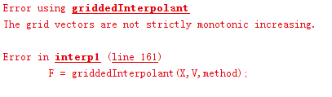
Project Progress
Step II: Data Interpolation
Syntax: ynew=interp1(x,y,xnew) —— 1-D interpolation
As in monotonic increasing:
Every element in the array must keep incrementing or decrementing
Neighbour elements in the array difference ≤ 0

Slide 6
Project Progress
Step II: Data Interpolation
Solution:
Function: unique – find repetition

Slide 7
Project Progress
Step II: Data Interpolation
Self-written function: avgdata=intpdd(FSZ,curve,structure)
Input: (in mm)
FSZ-field size eg.[100,100]
Curve-curve type eg. ‘PDD’
Structure-structure variable eg. hahaha
Output:
Avgdata-Averaged data w.r.t axis

Slide 8
Project Progress
Step II: Data Interpolation
Self-written function: avg=intpro(FSZ,curve,depth,structure)
Input: (in mm)
FSZ-field size eg.[100,100]
Curve-curve type eg. ‘IN’
Depth-scan depth eg. 50
Structure-structure variable eg. hahaha
Output:
Avg-Averaged data w.r.t axis

Slide 9
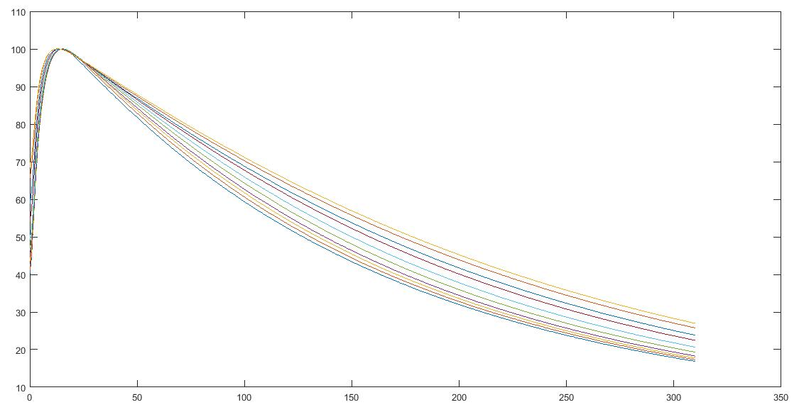
Project Progress
Step II: Data Interpolation

Slide 10
Future Work Plan
The interpolation method anlysis
Debug

Slide 11
THE END Thank you for your patience!

